Slide 1
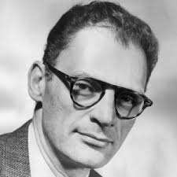
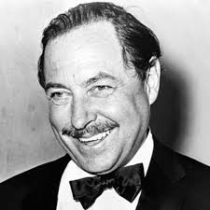
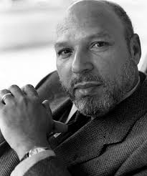
Unit 9
Great American Playwrights

Slide 2
Criteria for Greatness
These are just a few. There are too many to discuss in one course/one unit.
Have plays stood the test of time/ gotten better with years?
What is the audience appeal/ how often are they revived?
How are plays seen by the rest of the world?

Slide 3
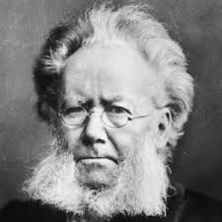
Henrik Ibsen
Father of modern drama
From Norway
Ibsen had a profound impact
On early, serious American
Playwrights.
American playwrights tend to have a regional connection because this country is so large.

Slide 4
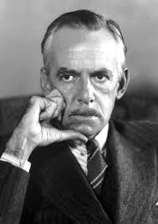
Eugene O’Neill
Father of serious, American
Theatre, strongly influenced by
Ibsen.
Had a tremendous impact on
The playwrights we discuss in
This unit.

Slide 5
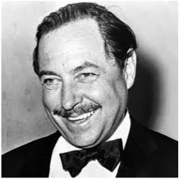
Thomas Lanier “Tennessee” Williams
1911-1983
born in Columbus, MS
St. Louis, MO
New Orleans
Early family life- inspiration for much of his work. Alcoholic father, mentally ill mother, brother favored by his father, sister who also suffered with depression/ insanity.
University of Missouri/ University of Iowa
First published play Battle of Angels not a success. Later re-written as Orpheus Descending.

Slide 6
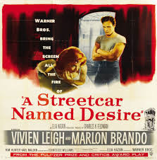
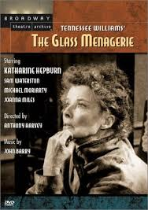
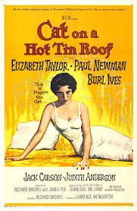
Major Plays
The Glass Menagerie
A Streetcar Named Desire
Cat on a Hot Tin Roof:

Slide 7
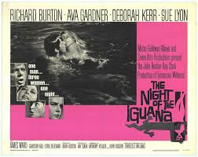
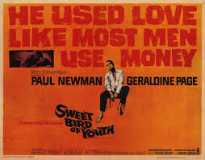
Other Great works
Summer and Smoke
The Night of the Iguana
Sweet Bird of Youth
The Rose Tattoo
Orpheus Descending

Slide 8
Importance of Williams’ Work
-beginnings of ‘serious’ theatre in America. Williams directly influenced by Ibsen, Eugene O’Neill
regionalism. Most of Williams’ plays set in the south.
themes- Williams asks the tough questions about human behavior/ American society.
‘Mendacity.’ Illusion VS Reality
A characters’ past affecting their present
Struggles within the confines of society- particularly industrial/ small town.
People rebelling against their core beliefs
The style of the language; a ‘poetic realism.’
‘holding a mirror up to nature,’ ‘the invention of the human.

Slide 9
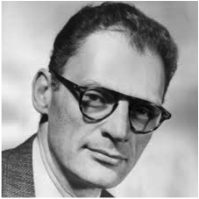
Arthur Miller
1915-2005
Born/ grew up in New York City.
Family was well off, but lost
everything in the 1929 Wall Street crash.
Attends the University of Michigan.
Joined the Federal Theatre Project
after graduation. Wrote radio plays for CBS after Congress shut down the FTP.
First play, The Man Who Had All the Luck, was a disaster.

Slide 10
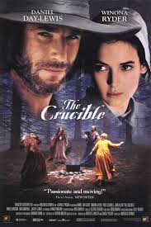
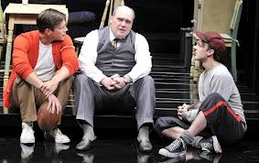
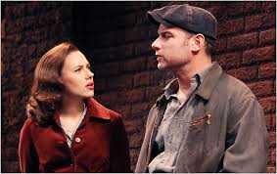
Major Plays
All My Sons
Death of a Salesman
The Crucible
A View from the Bridge

Slide 11
Biography continued
Elia Kazan and The Crucible (1953)
1956- marries Marilyn Monroe
1957- asked to appear before and sentenced by the HUAC. Sentence was overturned.
1961- Miller/ Monroe divorce. She dies less than two years later.
1962- married Inge Morath. They had two children, Rebecca & Daniel. Rebecca is married to Daniel Day Lewis.
Miller continued to write for stage and screen until his death, though none of his later plays have had the legacy of his earlier work.

Slide 12
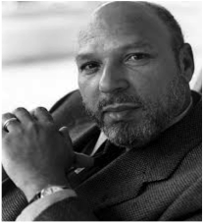
August Wilson
1945-2005
The Hill district of Pittsburgh, PA
White Father, Black Mother
Father was largely absent from childhood
Family forced to move, and Wilson forced out of
school several times because of threats.
Wilson made use of Carnegie Library of Pittsburgh
educated himself
Forced to leave home when he decided he wanted to be a writer.
Served in the army for several years and worked a variety of odd jobs.
1968- co-founded Black Horizon Theatre in Pittsburgh
1978- moved to St. Paul, MN. Worked with Playwrights Center and Penumbra Theatre Co.
1990- moved to Seattle. Worked with Seattle repertory theatre.

Slide 13
The Pittsburgh or ‘Century’ Cycle
1900s - Gem of the Ocean (2003)
1910s - Joe Turner's Come and Gone (1988)
1920s - Ma Rainey's Black Bottom (1984) - set in Chicago
1930s - The Piano Lesson (1990) - Pulitzer Prize
1940s - Seven Guitars (1995)
1950s - Fences (1987) - Pulitzer Prize
1960s - Two Trains Running (1991)
1970s - Jitney (1982)
1980s - King Hedley II (1999)
1990s - Radio Golf (2005)

Slide 14
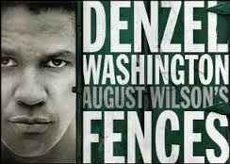
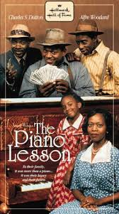
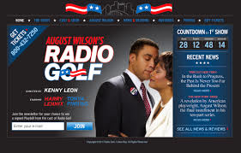
In production
Wilson was
Married 3 times
He died of liver
Cancer in 2005,
Shortly after the
Opening of his
Last play.

